Slide 1
Sustainability, Equity and Social Justice
Preparing today’s K-20 population for tomorrow’s sustainable world

Slide 2
?????????????????????
Why include
equity and social justice?

Slide 3
!!!!!!!!!!!!!!!!!!!!!!!!!!!!!!!!!!!!!!!!!
Sustainability as a new paradigm or ethos cannot be separated or isolated from the historical, political or economic realities of
social structure

Slide 4
Legacies of institutional racism
1846-1848 U.S.-Mexico War
1848 Annexation of the U.S. Southwest
Treaty of Guadalupe Hidalgo
Slow erosion of political and economic power of Mexican origin population
Official segregation policies
Loss of legal (juridical and legislative) power

Slide 5
Post-1880s legacy
Boom of West Coast agriculture
Era of Chinese and Asian exclusion laws
Loss of dependable “cheap labor” workforce
1880-present: Latinos position in the U.S. social structure is as:
“cheap labor”
Worker
Laborer (both skilled and unskilled)

Slide 6
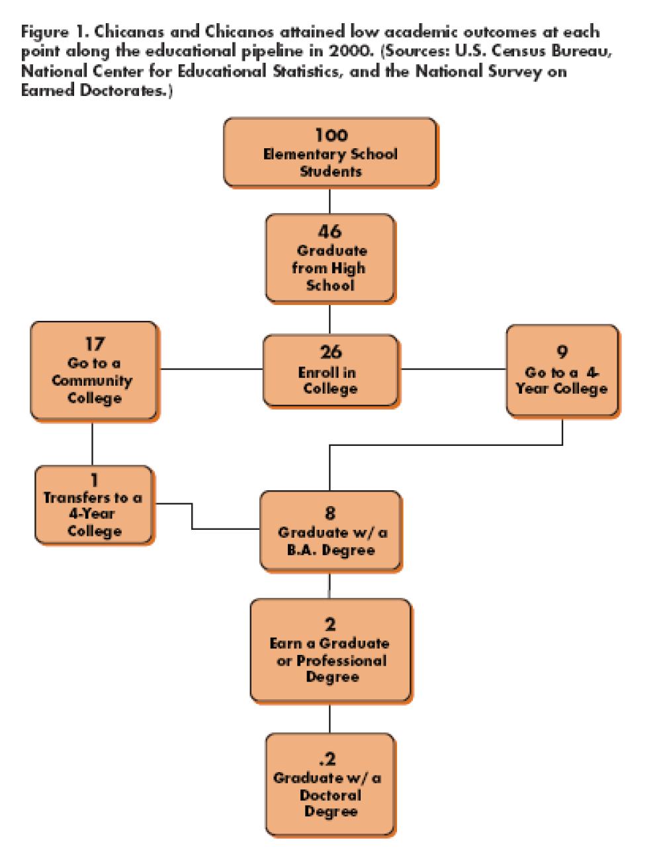
Educational Legacies

Slide 7
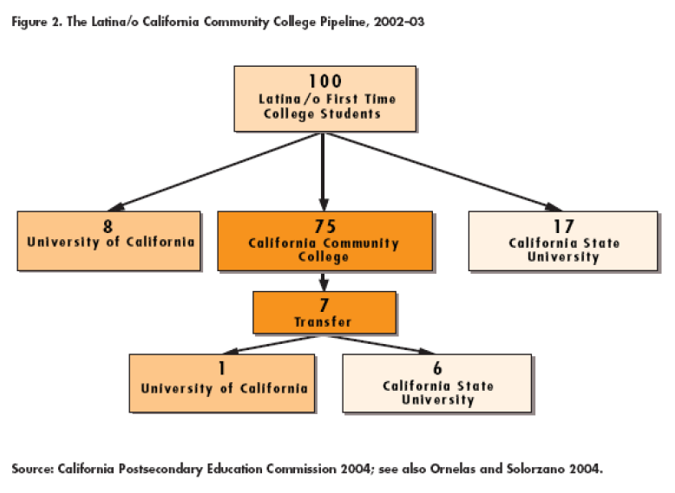

Slide 8
Creating a model of social transformation
Social Structure
Thinking
Imagination
Economics
Politics

Slide 9
From laborers to leaders
Expectations that more Latino students need to have access to higher education at the undergraduate (2 year and 4 year) and the graduate (MA, MBA, MSW, JD, MD, EdD, PhD, etc) levels

Slide 10
Understanding the skills of Latino Students
latimes.com
“Study finds traffic pollution can speed hardening of arteries”
People living within 328 feet of an L.A. freeway were found to have twice the average progression of atherosclerosis -- thickening of artery walls that can lead to heart disease and stroke.
By Margot Roosevelt

Slide 11
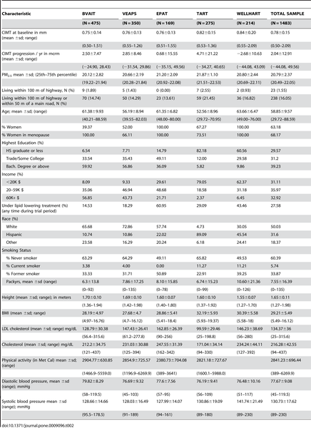

Slide 12
Organic Intellectuals and non-traditional “assets”
Students lived experiences with non-sustainability practices
Eye witnesses to impact of poor urban planning, environmental and economic policies and short sighted laws

