Slide 1


welcomes you to…
… Destination: Hispanic Higher Education Success
Notes:
I. A. Welcome & Opening Remarks Dr. Milton Gordon
B Introductions
(Go to next slide for Agenda)

Slide 2
Agenda
Welcome & Opening Remarks
Hispanic Higher Education & HACU
Discussion, Questions & Answers
How You Can Help to
Champion Hispanic Higher Education Success
V. Closing Comments
Notes:
II. Hispanic Higher Education & HACU Dr. Antonio Flores
- Thank you, Dr. Gordon. *
- Our thanks to Cal State Fullerton for hosting us.
- Thank you all for attending
- We hope to have a dialogue.
- I will speak about the state of Hispanic Higher Education .
- I’ll mention what HACU is doing in this area.
- And I invite you during the Discussion period to share thoughts on what you and others in your communities are doing in this area.
- Lastly, Erica Romero will outline ways that you can help to champion Hispanic Higher Education success in collaboration with HACU.
- Handouts of the slides are available as you exit.
- And you each have a packet of information .
- Let me call your attention to two items in your packet (hold up each item):
- A “Briefing Book” contains detailed information that may be of interest.
- It also contains pages on which you can take your own notes.
- There is also an “Interest Form” which we would ask you to please fill out and leave with us, indicating how we can help you to champion Hispanic Higher education success, and vice versa.
Now let’s get started.
*(Text in red varies by site.)

Slide 3

¡Bienvenidos!
San Juan, Puerto Rico
Hartford, CT
Bogotá, Colombia
Monterrey, Mexico
Chicago, IL
Guanajuato, Mexico
Guadalajara, Mexico
Albuquerque, NM
Denver, CO
San Diego, CA
Fullerton, CA
Los Angeles, CA
Long Beach, CA
San José, CA
Fresno, CA
Washington, DC
Phoenix, AZ
Atlanta, GA
San Antonio, TX
Miami, FL
New York, NY
Mexico, City, Mexico
Houston, TX
Dallas, TX
Rio Grande Valley, TX
Notes:
This is our latest of some two dozen “HACU on the Road” stops.
- As you can see, we have many more stops planned.
- And why is it important that we “hit the road” to call attention to the state of Hispanic Higher Education?

Slide 4

The State of
Hispanic Higher Education
By 2025, Hispanics will represent one of every two new workers entering the U.S. labor force.
Educating the workforce of tomorrow is a national imperative.
Notes:
Within fewer than 20 years, Hispanics will represent one of every two new workers entering the U.S. labor force.
Already, they comprise more than one of every three new workers.
Yet, the nation’s ability to compete in the global economy is, and will continue to be, limited by the level of education attained by members of this community.

Slide 5
The State of
Hispanic Higher Education
More than 46 million Hispanics in the United States.
Approximately 15% of the population (2007).
The National Center for Education Statistics (May 28, 2009) released the following data on degree completion by race and ethnicity for 25- to 29-year-olds:
Bachelor’s Degree Master’s Degree
Race/Ethnicity 1971 2006 Race/Ethnicity 1995 2008
White 19% 37% White 5.3% 8.2%
Blacks 7 20 Blacks 1.8 4.4
Hispanics 5 12 Hispanics 1.6 2.0
Asian/PI 42 58 Asian/PI 10.9 19.9
Notes:
There are more than 46 million Hispanics in the United States, representing approximately 15% of the population (2007).
As you can see, there are also significant gaps in enrollment and attainment levels for Hispanics.

Slide 6
The State of
Hispanic Higher Education
13,452,939 Latinos in California (2008).
36.6% of the population is Latino.
504 of 1,131 CA school districts (55%) have enrollments that are more than 25% Latino.
258 CA school districts (23%) have more than 50% Latino enrollments.
27.6% of CA college and university enrollment is Latino.
Notes:
- Here in California, there are estimated to be 13,452,939 Latinos in the state.
- They represent approximately 37% of the population.
Currently, out of the 1,131 school districts in California, 504 (55%) of them have more than 25% Latinos as part of their total student enrollment.
- 258 districts (23%) are more than half Latinos.
- Since Latinos are the youngest and fastest-growing segment of the population nationwide, these numbers are sure to continue growing.
- Our challenge is to make sure that the last statistic also grows – the percentage of college enrollment for Latinos.

Slide 7
The State of
Hispanic Higher Education
382 HACU
Members
in 32 states,
DC & PR
MI 2
WA 4
MT 1
WI 2
ID 2
IA 2
NY 29
MA 5
IL
15
PA 5
CA
109
NV 3
UT 1
CO 12
KS 7
MO 3
OH 4
CT 4
VA 3
NJ 8
NM 15
OK 1
AR 1
TN 2
NC 4
DE 1
AZ 16
MD 2
enroll 2/3 of
the nation’s 2.3 million
Hispanic college students.
AL
2
GA
3
TX 64
D.C. 1
FL
16
PR 33
States with HSI members
States with members
Notes:
And throughout the U.S. and Puerto Rico, where does one find the majority of Hispanic college students?
I am pleased to say that the 382 HACU-member institutions – even though they represent less than 10% of all colleges and universities in the U.S. – enroll two-thirds of the nation’s Latino college students.
States with HACU members are shown in blue.
Dark blue states like California are those that include members that are “Hispanic-Serving Institutions” or HSIs, with Hispanic enrollment of 25 percent or more.

Slide 8
The State of
Hispanic Higher Education
  HACU Members in California
77 Hispanic-Serving Institutions
29 Associate Member Institutions
3 Partner Institutions
4 Hispanic Serving School Districts (HSSDs)
  Hispanic-Serving Institution (HSI) = 25% + Hispanic enrollment
  Associate Member Institution (AMI) = 10% +
  Partner Institution (PI) = Less than 10%
  HSSDs = 25% + Latino enrollment
Notes:
Here in California, we currently have 77 dues-paying HSI members.
Our 29 Associate Member Institutions in California, are those that have enrollments that are between 10% and 24% Hispanic,
Our 3 Partner Institutions are those that have less than 10% Hispanic enrollment but that share our commitment to Hispanic higher education success.
HACU’s commitment dates back to our founding nearly 23 years ago.

Slide 9
About HACU
Founded in 1986.
Helped shape definition of HSIs in Higher Education Act of 1992.
Helped secure more than $1.2 billion in federal funding for HSIs since 1995.
Still, HSIs receive 52 cents in federal funding for every dollar that goes to non-HSIs.
Notes:
HACU has been advocating for Hispanic Serving Institutions and Hispanic higher education since the association was founded in 1986.
We were instrumental in shaping federal legislation that defined HSIs for the first time in 1992.
HACU’s advocacy efforts with the federal government in Washington, DC, have helped to secure over $1 billion in grants targeted to HSIs since 1995.
But much work remains. Still, HSIs receive on average just 52 cents in federal funding for every dollar that goes to non-HSIs.

Slide 10
About HACU
Notes:
As shown on the chart on page 4 of your Briefing Booklet, California institutions have received $266 million in Title V funds.

Slide 11
Mission
To champion Hispanic success in higher education.
Promoting development of member colleges and universities;
Improving access to and the quality of post-secondary educational opportunities for Hispanic students;
Meeting needs of business, industry and government through the development and sharing of resources, information and expertise.
Notes:
The mission of HACU is “To Champion Hispanic Success in Higher Education.”
We implement our mission in the ways shown here:
Promoting development of member colleges and universities;
improving access to and the quality of post-secondary educational opportunities for Hispanic students;
meeting the needs of business, industry and government through the development and sharing of resources, information and expertise.

Slide 12
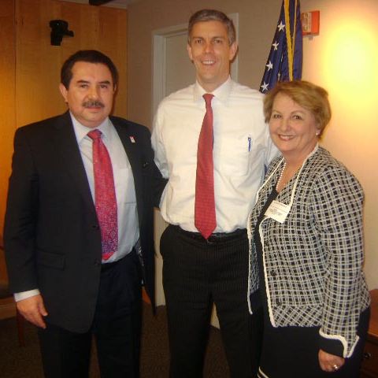
National Member
Benefits
Advocacy - Governmental Relations
  Offices in Washington, DC
  Sacramento, CA
  San Antonio, TX
Institutional Capacity Building
Faculty and Staff Development
Member Advisories
Action Alerts
HACU Scholarships
  More than $400,000 this year
Notes:
HACU member benefits extend beyond HSIs to all our National Members, including our Advocacy and Governmental Relations efforts.
Earlier this year I met with Secretary of Education Arne Duncan, along with one of our member presidents, Dolores Fernandez.
HACU is the voice of Hispanic higher education on Capitol Hill. We have an office in Washington, DC, a Western Regional Office in Sacramento, California, and are headquartered in San Antonio, Texas.
We assist institutions with their capacity-building and Faculty & Staff Development.
Member Advisories and Action Alerts update members on important developments in U.S. public policy affecting Hispanic higher education, the latest legislative developments, and funding opportunities.
More than $400,000 in HACU Scholarships will be awarded this year to students at member institutions, thanks to our partners.

Slide 13
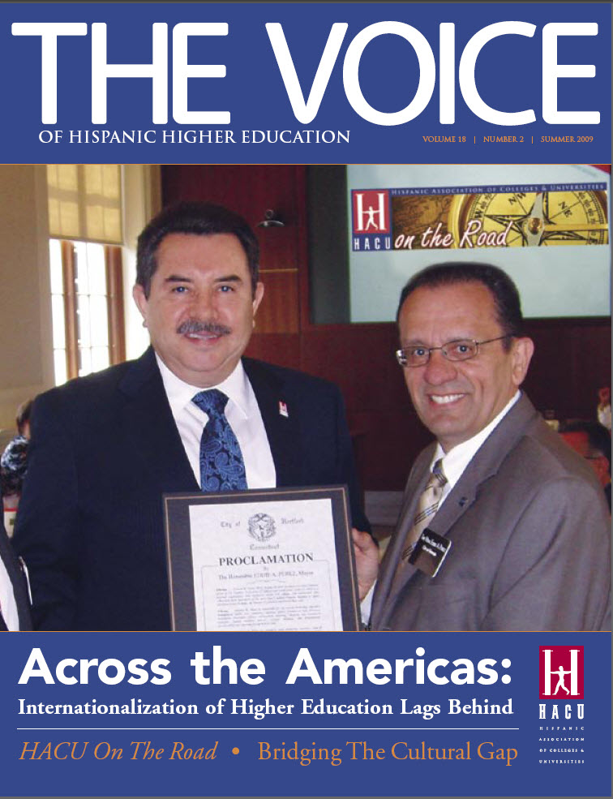
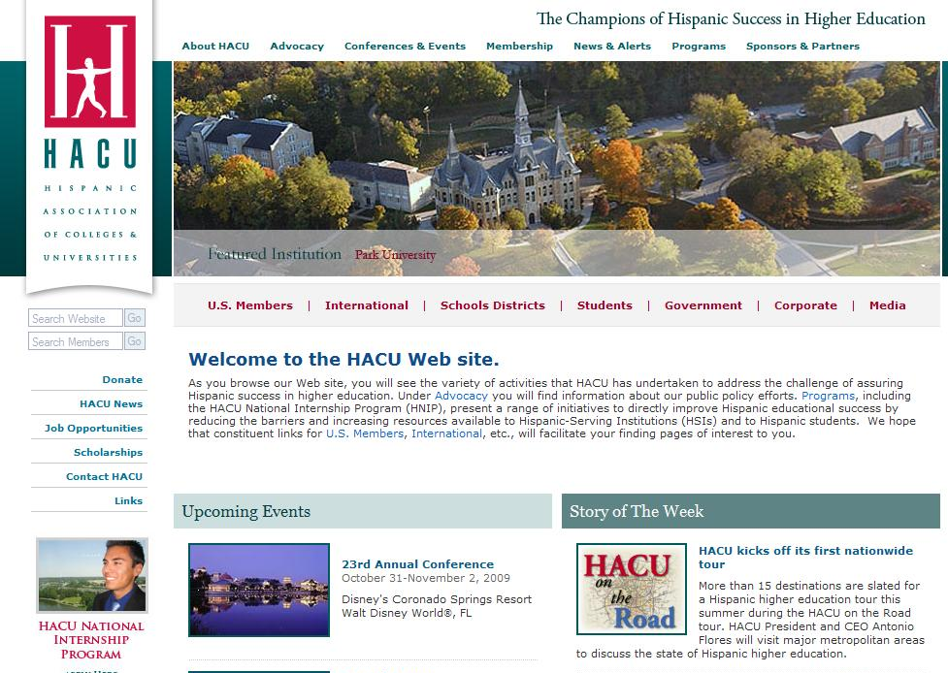
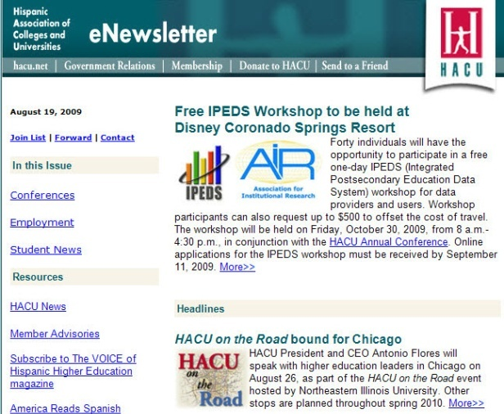
Member & Corporate
Partner Benefits
Marketing, Sales & Recruitment
  www.hacu.net
  Monthly e-newsletter
  Quarterly Magazine
Notes:
Benefits for our partners and corporate supporters include support of your marketing, sales and recruitment efforts.
Members and partners alike benefit from marketing available through:
the HACU Web site
Our monthly e-newsletter
- and our quarterly magazine, The Voice of Hispanic higher Education

Slide 14

Member & Corporate
Partner Benefits
Conferences and Events
  Capitol Forum
  International Conference
  23rd Annual Conference
    Oct. 31 – Nov. 2
    Walt Disney World Resort
    1,300+ attendees
    200+ students at
    Student Track
Notes:
Marketing and networking opportunities abound at our Conferences and events, including:
- Our Capitol Forum held each spring in Washington, DC
- Our biennial conference, held this past April in Guadalajara
- And our largest event, the Annual Conference
From October 31 to November 2 this year convened some 1,300 people in Disney World Resort, Florida.
Workshops, exhibits and networking opportunities have proven to be of interest to educators and sponsors alike.
Our Student Track brought together some 200 students, made possible in part by Student track scholarships from partners and member institutions.

Slide 15

Member & Corporate
Partner Benefits
Diversify your Workforce
  Job Postings on
  ProTalento : The HACU
  Professional Résumé Database
HACU National Internship
Program
  600 + students per year
  Nearly 9,000 interns since 1992
  Federal Agencies
  Corporations
Notes:
Another partner benefit of interest to many of you is the Diversification of your workforce.
We have redesigned our job posting service under the new name
“ProTalento – The HACU Professional Résumé Database.”
The HACU National Internship Program is the largest Latino internship program in the nation, with more than 600 participants per year interning at federal agencies and corporations.
Shown here in the center is Grisel Gutierrez, one of Deloitte’s HACU interns from last summer.

Slide 16




Corporate
Partner Benefits
Strategic Alliances
Customized
programs
Notes:
Partner benefits can include strategic alliances and customized programs.
HITN partners with HACU on the production of a Spanish-language television series explaining the college admissions process.
Hobsons partners with HACU to promote our member institutions in their print and online college guide directories.
Gap partners with HACU on a fashion design competition that culminates in a walk down the fashion runway at our Annual Conference, with the winners receiving scholarships.
Southwest airlines and HACU have collaborated for the past five years on the Lánzate program, “Giving Flight to your Success.”
- Round-trip airline tickets are awarded to deserving students who travel away from home to attend college.
- Southwest also provide HACU with tickets for staff travel to our conferences.

Slide 17

International Membership
México 26
50 International HACU Members in 10 Countries
Nicaragua 1
Guatemala 1
Spain 12
Costa Rica 1
Brazil 1
Colombia 5
Ecuador 1
Portugal 1
Paraguay 1
Notes:
For those of you from both the corporate and educational communities wishing to reach out internationally, HACU also has 50 International Members in 10 countries.

Slide 18
23 HSSD
Members in 9 States
Arizona (2)
Agua Fria Union High School District #216
Mesa Unified School District #4
California (4)
Cutler-Orosi Joint Unified School District
East Side Union High School District
Hayward Unified School District
San Bernardino City Unified School District
Colorado (1)
Weld County School District Re-3J
Illinois (1)
Reavis High School District 220
New Jersey (3)
Elizabeth Public Schools
Passaic County Technical Institute
Red bank Board of Education
New Mexico (1)
Albuquerque Public Schools
New York (1)
Yonkers City School District
Pennsylvania (1)
School District of Lancaster
Texas (9)
Fort Worth Independent School District
Glen Rose ISD
Hidalgo Independent School District
La Joya Independent School District
Northside Independent School District
Seguin Independent School District
Southwest Independent School District
Valley View ISD
Ysleta Independent School District
Notes:
One of our newest initiatives is the establishment of an Affiliate Membership for Hispanic-Serving School Districts, or HSSDs, that have enrollments that are at least 25 percent Latino.
We currently have 23 such HSSD members in 9 states , including 4 HSSDs in CA
Our hope is to foster collaborations between our HSSDs and our member institutions of higher learning to address the pipeline issues that are negatively impacting Hispanic higher education Success.

Slide 19

The HACU Center
for Higher Education Success
  National Innovation Center on Hispanic Education
  Latino College Planning and Testing Initiative
  Financial Literacy Institute
  Hispanic Higher Education
  Hall of Champions
Notes:
Lastly, as HACU approaches its 25th anniversary in 2011, our Governing Board has decided that fiduciary responsibility dictates that the association secure a permanent headquarters (in lieu of leased space) that also reflects the permanence of our commitment to higher education success.
So we have launched a Feasibility / Planning Study for the construction of The HACU Center for Higher Education Success to be built in San Antonio.
Our current and prospective corporate partners may be interested in participating in the study to learn about the named giving opportunities associated with proposed components such as…
National Innovation Center on Hispanic Education, providing information and policy analysis;
Latino College Planning and Testing Initiative, creating a college-going environment through Student Success Centers in select high schools located in Hispanic-Serving School Districts throughout the U.S.;
Financial Literacy Institute, helping parents and students prepare financially for college and beyond;
Hispanic Higher Education Hall of Champions, recognizing individuals and institutions that have contributed to the advancement of Hispanic higher education; and
HACU Headquarters, encompassing Student Services, Conferences and Events, International Affairs and other Programs and Services that advance Hispanic higher education

Slide 20
Dialogue
Discussion, Questions & Answers
Existing collaborations in your communities
Suggestions
Notes:
I am eager to hear from all of you:
-- what questions you may have
-- what collaborations you may already be involved in
- and what suggestions you may have

Slide 21
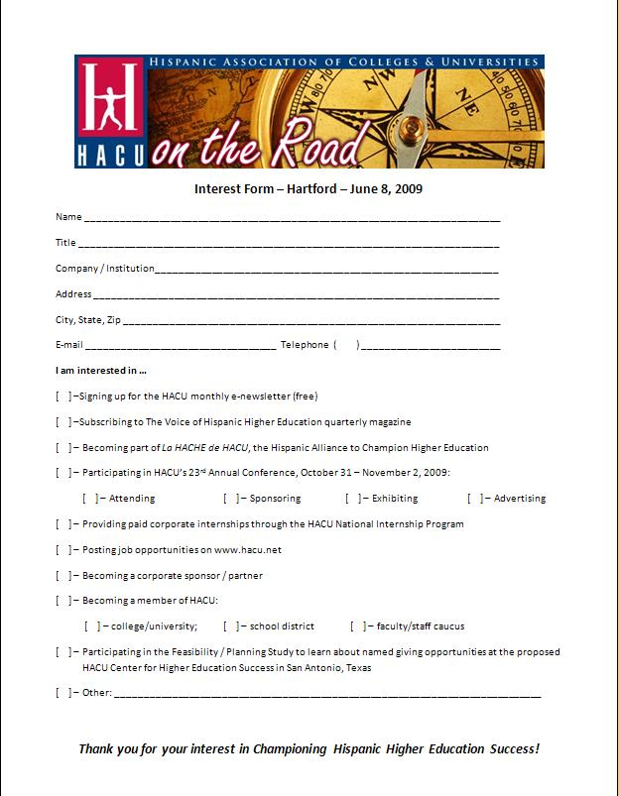
How You Can Help to
Champion Hispanic Higher Education Success
Let us know of your interest in pursuing the member or partner benefits outlined today
Notes:
How You Can Help to Champion
Hispanic Higher Education Success Erica Romero
- As Dr. Flores mentioned, we would ask you to please fill out the “Interest Form” to let us know your interest in pursuing the member or partner benefits outlined today.

Slide 22

Stay Informed
Sign up for HACU’s monthly e-newsletter
Notes:
How You Can Help to Champion
Hispanic Higher Education Success
- For example, you can check the first box to receive our free monthly e-newsletter.

Slide 23

Stay Informed
Subscribe to The Voice of Hispanic Higher Education, HACU’s quarterly magazine
Notes:
- You can also subscribe to our quarterly magazine, The Voice of Hispanic Higher Education

Slide 24
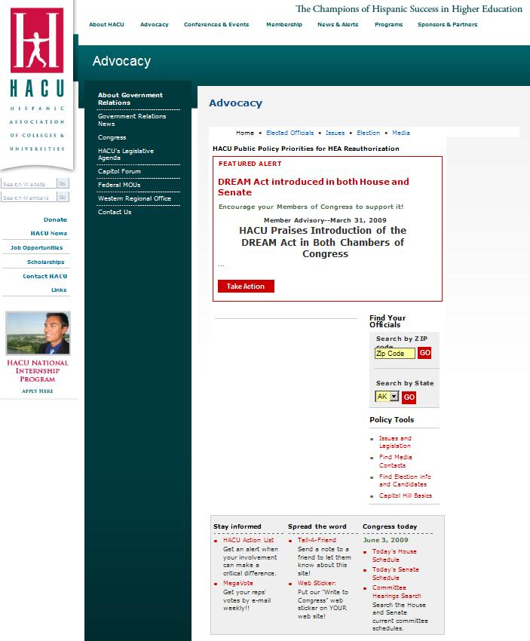
Become An Advocate
Visit www.hacu.net to send a message to your elected officials
Notes:
By providing us with your e-mail address, you can join others who advocate with their elected officials through our online advocacy system

Slide 25

Become Part of
La HACHE de HACU
Join individuals in HACU’s “Hispanic Alliance to Champion Higher Education”
Notes:
- And if you have not already done so, we hope you will join HACU’s “Hispanic Alliance to Champion Higher Education” – La HACHE de HACU – for 2009 by making a donation to our Annual Appeal. A form and envelope are provided in your packet.

Slide 26

Join us at the
Capitol Forum
Participate in HACU’s 15th Annual National Capitol Forum through:
  Attending
  Sponsoring
  Advertising
April 18 – 20, 2010
The Madison Hotel Washington, D.C.
Notes:
We hope you will join us at HACU’s 15th Annual National Capitol Forum, scheduled for April 18-20 in Washington, DC.

Slide 27

Join us at the
Annual Conference
Participate in HACU’s 24th Annual Conference through:
  Attending
  Sponsoring
  Exhibiting
  Advertising
September 18 – 20, 2010
Hilton San Diego Bayfront
San Diego, CA
Notes:
And our next Annual Conference will take place September 18-20 in San Diego.

Slide 28
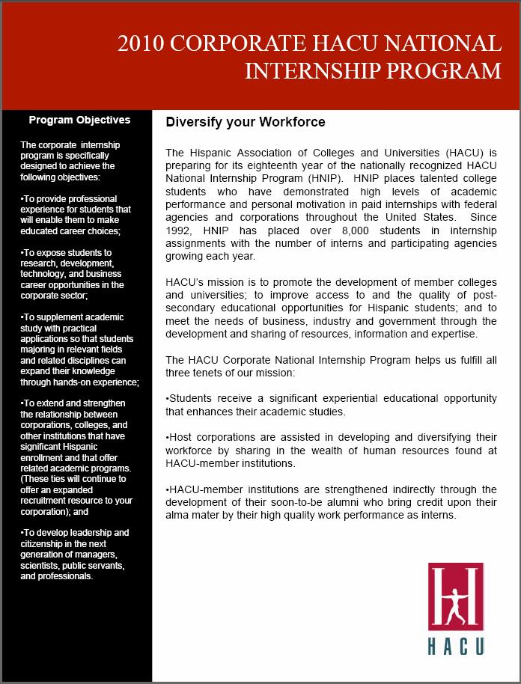
Diversify Your Workforce
Participate in the
HACU National Internship Program
Post jobs on ProTalento: The HACU Professional Résumé Database

Slide 29
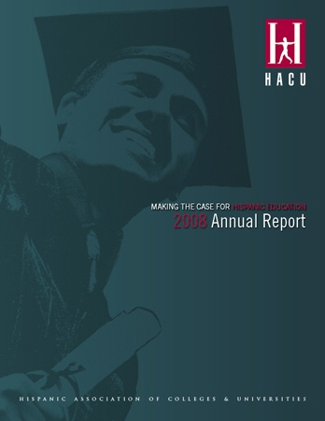
Let us Recognize You
Members, donors and sponsors are recognized in HACU’s Annual Report and on www.hacu.net.

Slide 30
Help Build the Future
Participate in HACU’s Feasibility / Planning Study
The HACU Center for Higher Education Success

Slide 31
thank you for participating in …
… Destination: Hispanic Higher Education Success
Notes:
V. Closing comments: Host institution representative

